Slide 1
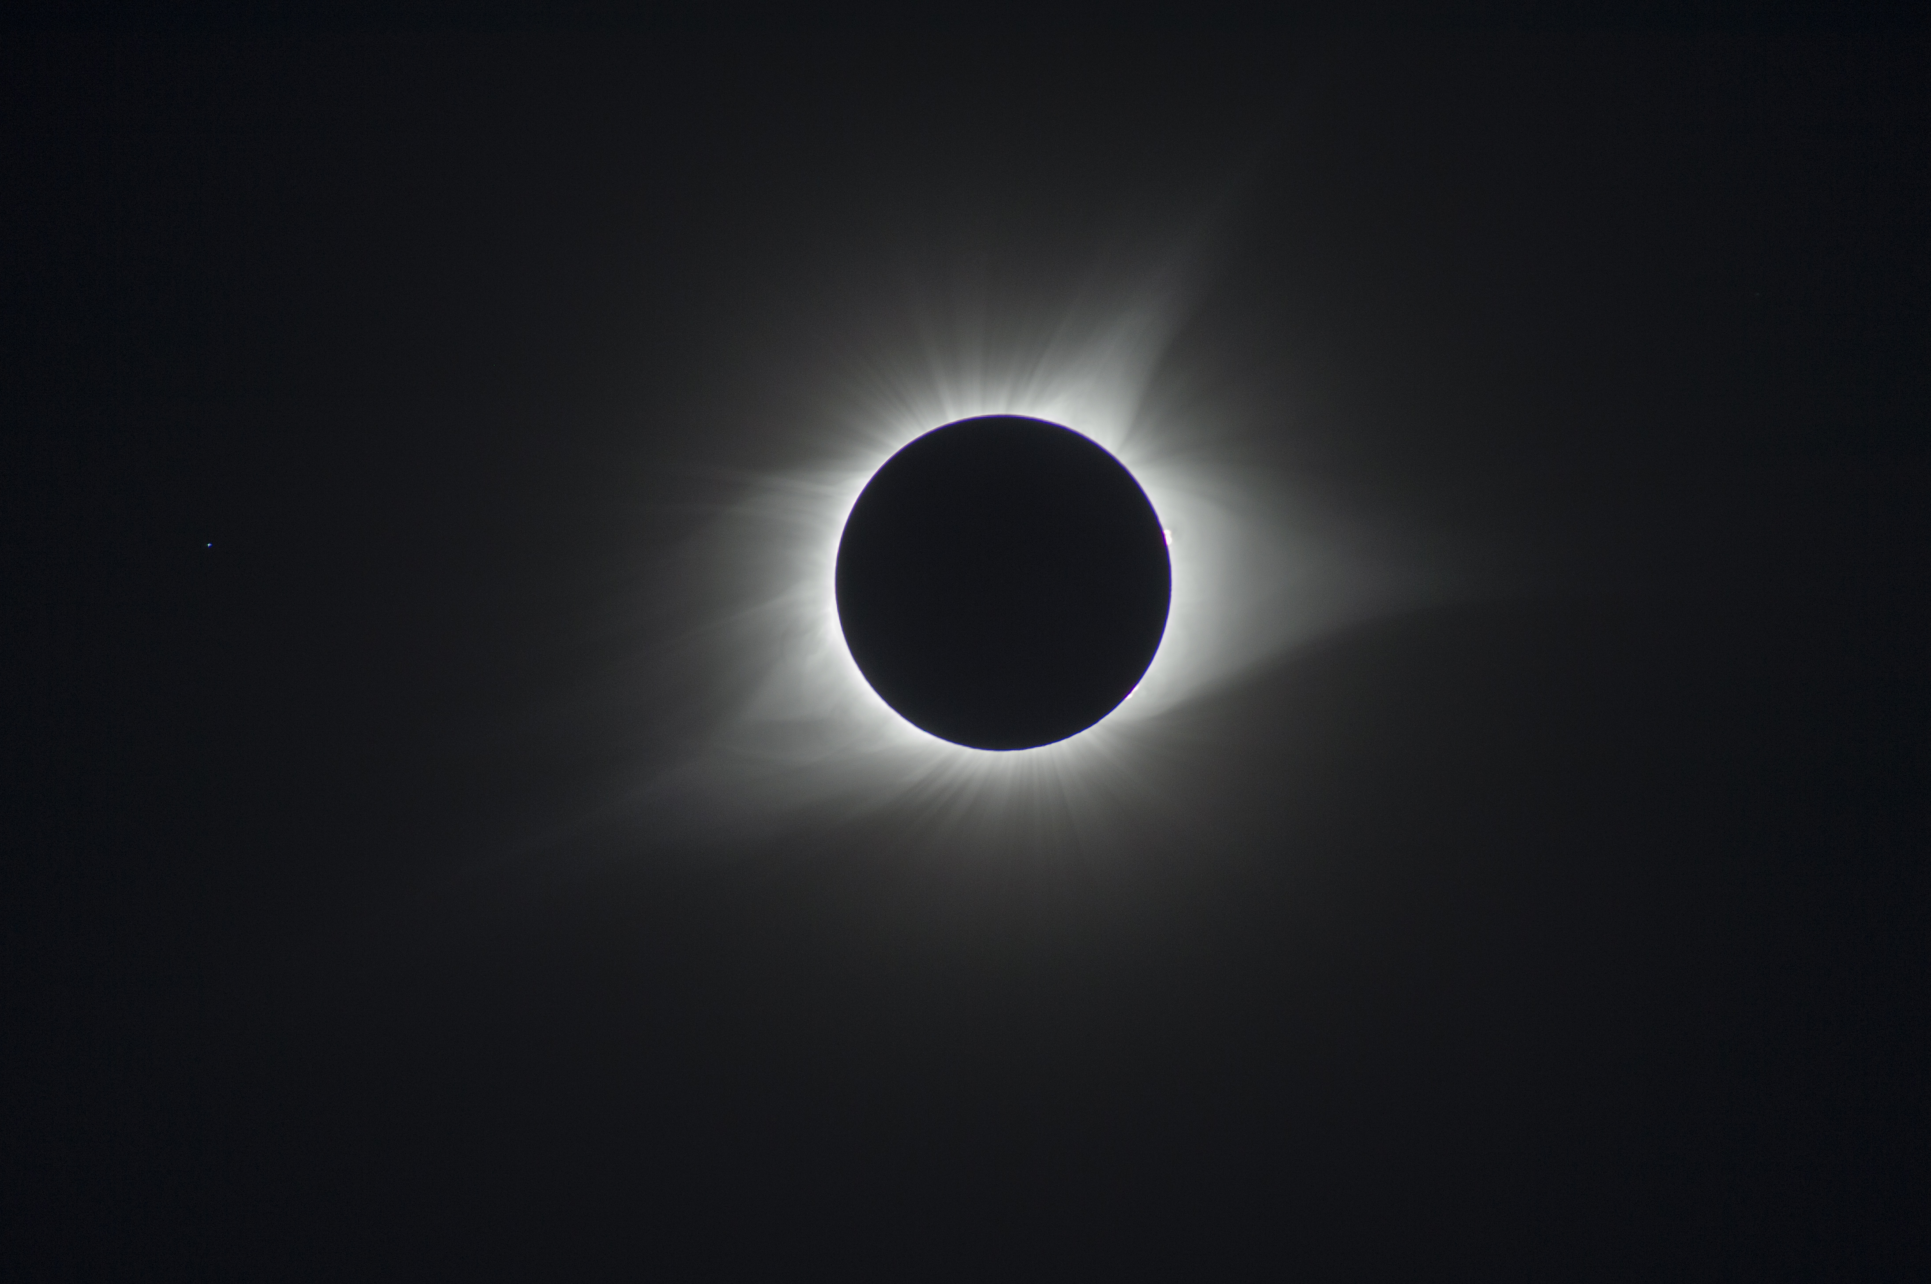
Using Solar Observations as a Guide, How Have the Data and the Analysis Changed in ~600 Years?
for Women in Data Science - Virtu
Tuesday March 8, 2022 – 11:00 a.m. CT
Mitzi Adams, MSc
NASA/Marshall Space Flight Center
Background Image: Joe Matus, NASA/MSFC, August 21, 2017

Slide 2
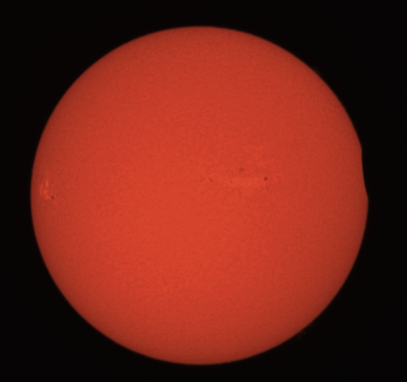
Outline
A bit of history
The Sun vs. a couple of stars
  - What is a Star?
  - What is the Sun like?
Eclipses
Solar Eruptions
Jets in Coronal Holes
First Contact, August 21, 2017 Solar Eclipse
in Hydrogen-alpha
Image Credit: Mitzi Adams, NASA/MSFC, August 21, 2017
from Clarksville, Tennessee

Slide 3
Galileo Observations c. 1609

Slide 4
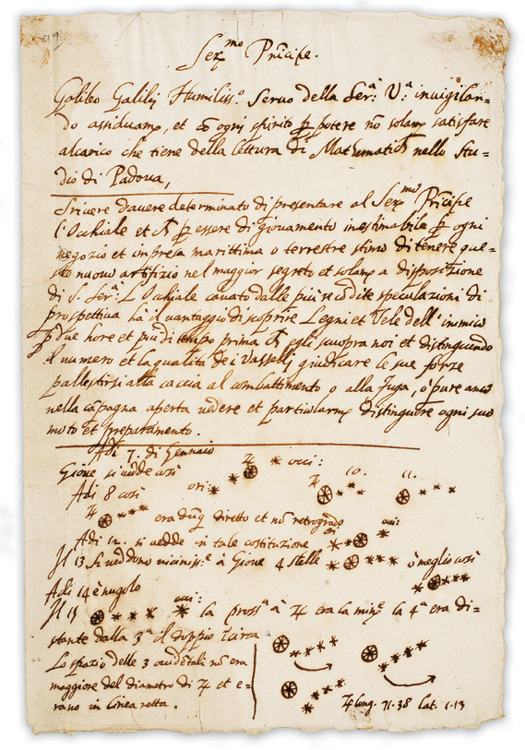
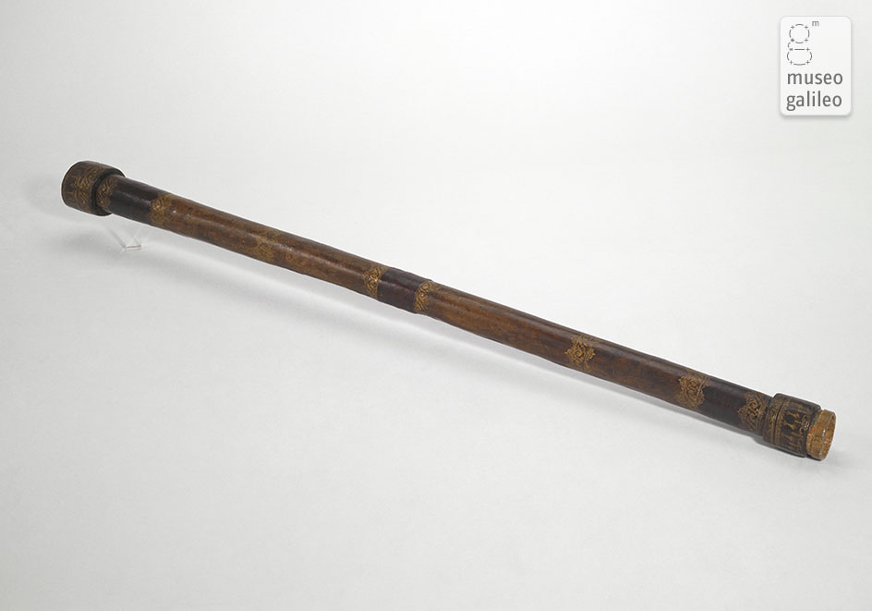
Galileo’s Telescope, c. 1609. Tube is wood
covered with red leather, plano-convex
objective, diameter 37 mm, focal length
980 mm, magnification 21, field-of-view 15’.
Thanks to the Museo Galileo for permission
to use the image.
Shown is a draft of a letter to the Doge of Venice, Leonardo Donato, August, 1609
From https://solarsystem.nasa.gov/news/307/galileos-observations-of-the-moon-jupiter-venus-and-the-sun
Credit: University of Michigan Special Collections Library

Slide 5
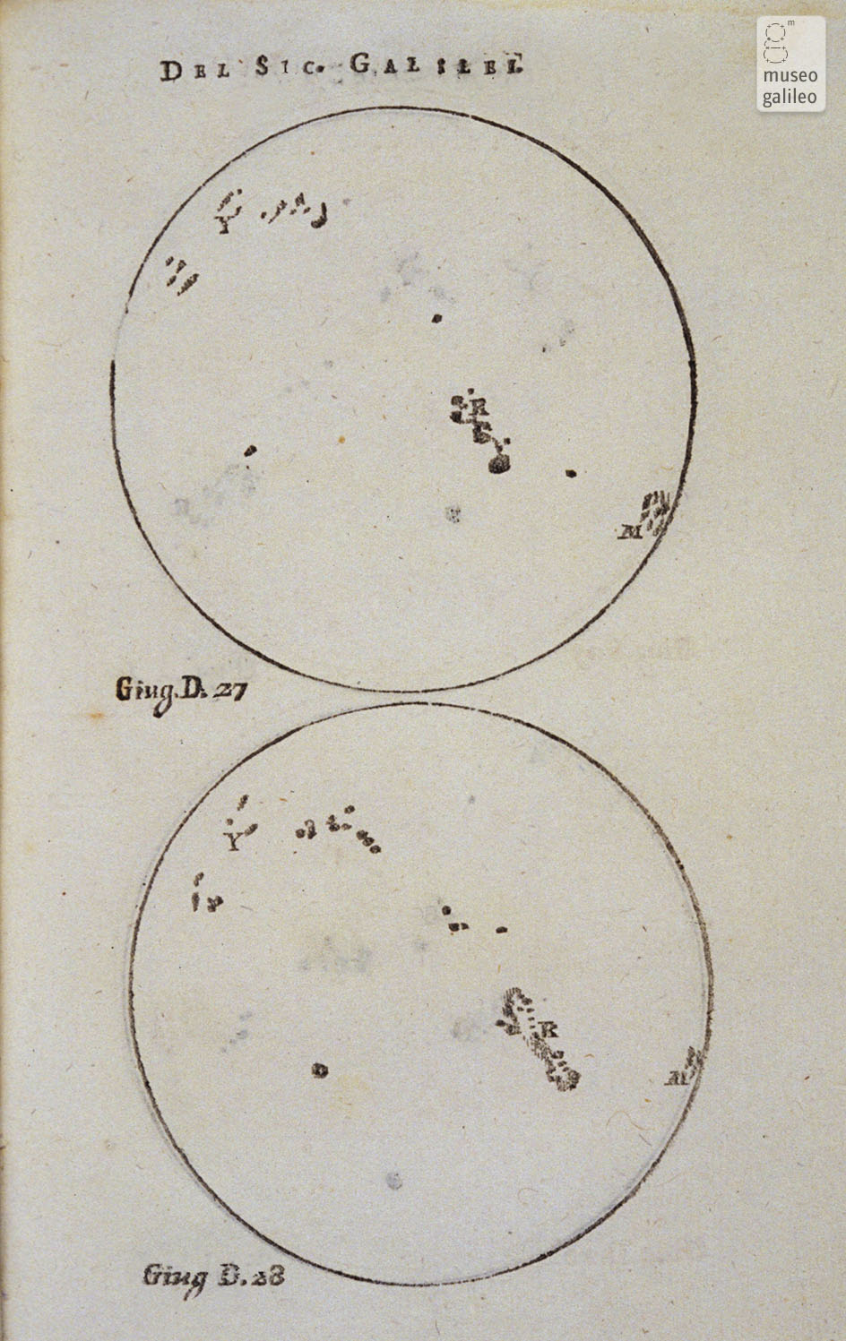
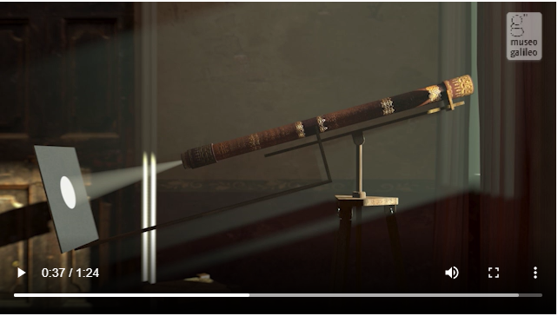
https://catalogue.museogalileo.it/gallery/Sunspots.html
https://catalogue.museogalileo.it/multimedia/Helioscope.html

Slide 6
Female Pioneers of Astronomy
Beginning Approximately 1850

Slide 7
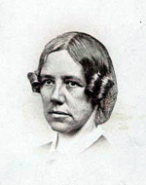
Maria Mitchell: Educating
Future Scientists
Discovered a comet in 1847 at age 29
First woman elected to the American
Academy of Arts and Sciences (1848)
First woman elected to the American
Association for the Advancement of Science(1850)
First professor hired at new Vassar College (1865)
Co-founded the Association for the Advancement of Women (1873)
Led an all-female eclipse expedition from Vassar College to outside
Denver in 1878

Slide 8
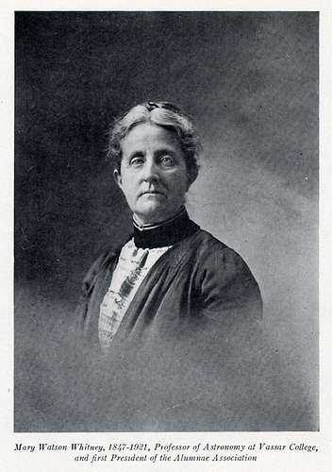
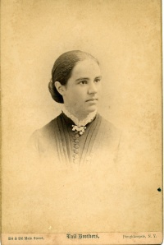
Maria Mitchell: Her Legacy -
Her Students
Mary Watson Whitney -- Succeeded
M. Mitchell as Chair of Astronomy
Department and Director of Observatory
and Educator
Antonia Maury -- Became one of
Edward Pickering's “computers” who
published in 1897 a catalogue of
stellar spectra -- first observatory
publication credited to a woman
Image Credit: Vassar College Special Collections Library

Slide 9
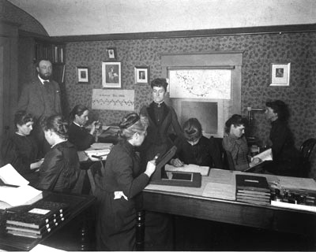
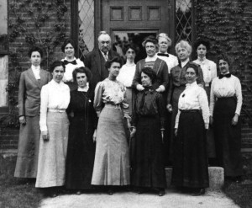
Edward Pickering and the “Computers”
at Harvard Observatory
At Harvard College Observatory,
13 May, 1913
Image Credit: Licenced under Public Domain via Wikipedia
Commons - http://commons.wikipedia.org)
William Pickering and his “computers”
Antonia Maury on the far left with back to camera
Annie Cannon on far right
Image Credit: Vassar College Special Collections Library

Slide 10
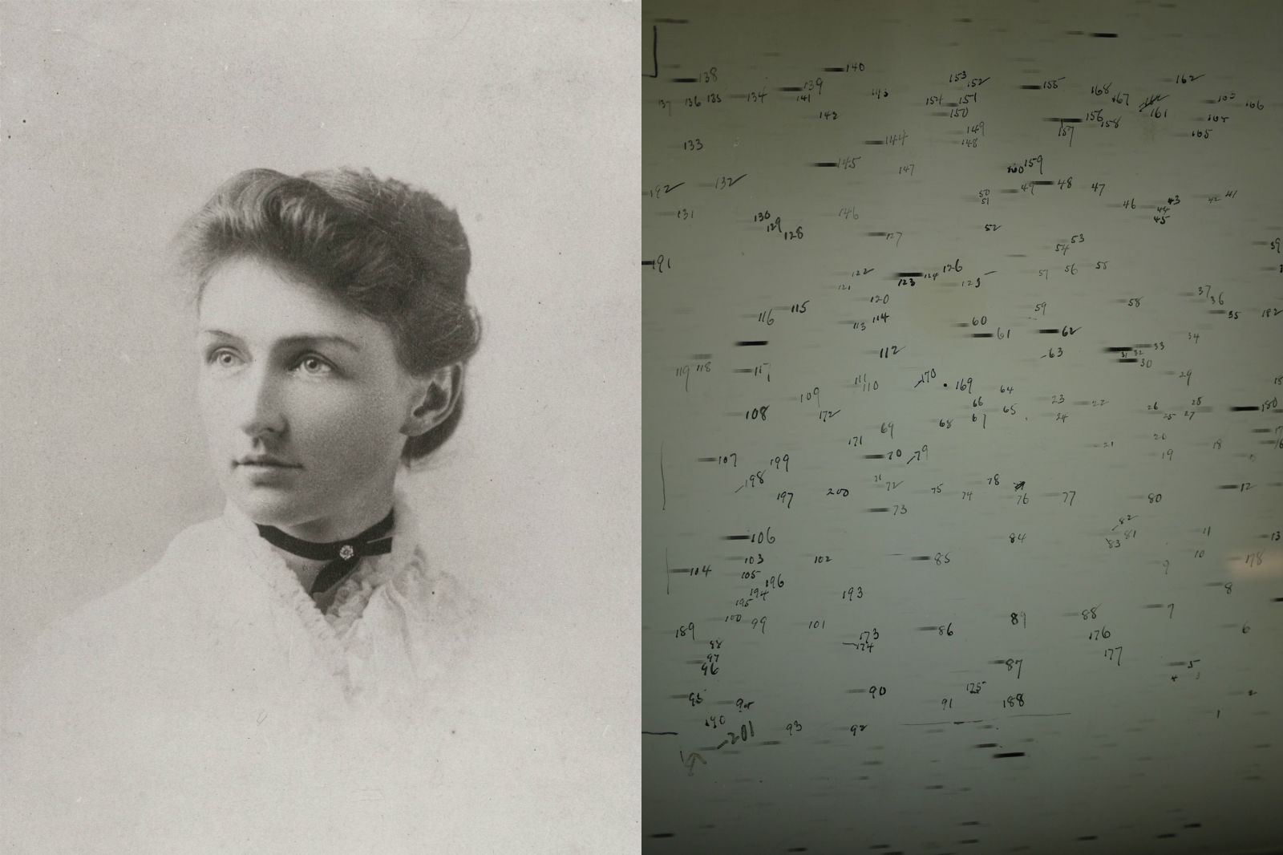
Annie Cannon and Spectral Classifications
Annie Cannon (image from 1895) classified spectra of more than 425,000 stars
Image Credit: Harvard College Observatory

Slide 11
Harvard Computers
Williamina Fleming Office Manager and classifier of stellar spectra
Antonia Maury Improved classification system
Annie Jump Cannon Classified spectra of southern stars and redesigned system,
developed Harvard Classification System
Cecilia Payne-Gaposhkin Determined the relationship between stellar classes and stellar temperature and determined that the Sun is mostly
hydrogen
Henrietta Swan Leavitt Intuited that all stars in Small Magellanic Cloud are approximately at the same distance from Earth, leading to her discovery of direct relationship between period and luminosity of Cepheid variables
Anna Winlock Made the most complete catalog of stars near north and south Poles (of her time), and calculated orbits and compiled data on asteroids

Slide 12
The Sun vs. a Couple of Stars
What is a Star?
- Energy Production
- Differences
- H-R Diagram
What is the Sun like?
- Structure
- Surface Features
- Magnetic Fields
- The Solar Cycle
- Solar Eruptions

Slide 13
What is a Star?

Slide 14
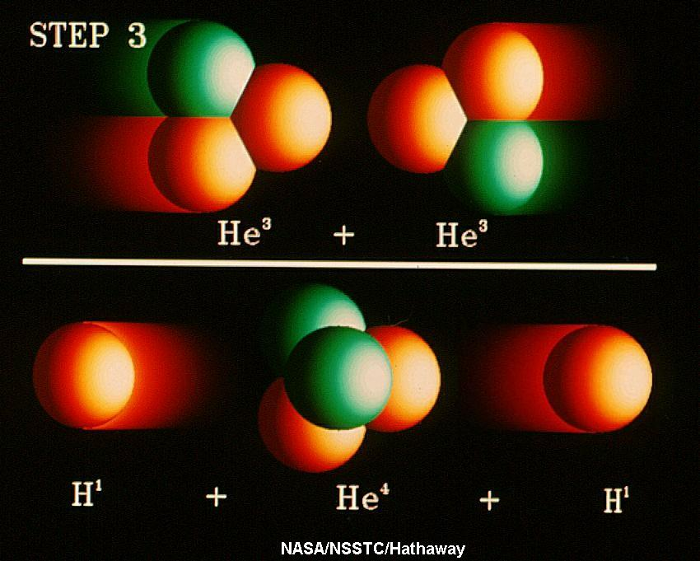
What is a Star? -- Energy Production
A star is an astrophysical body that produces its own light by
thermonuclear reactions in its core.
For solar-type stars, this is the proton-proton chain
1. Two protons collide,
form deuterium,
a positron, and
a neutrino.
2. A proton collides with
the deuterium, forming
helium-3 and a gamma
ray
3. Two He-3s collide to form He-4 plus two protons.
Basically, Hydrogen converts to Helium
(High-mass stars, greater than about 2 solar masses use a different procedure, the CNO cycle.)

Slide 15
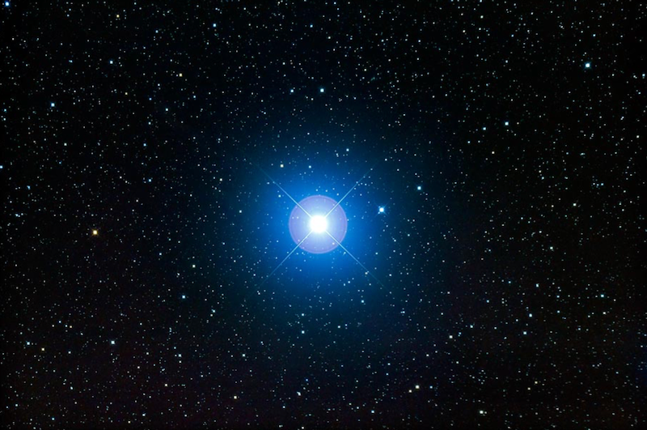
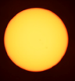
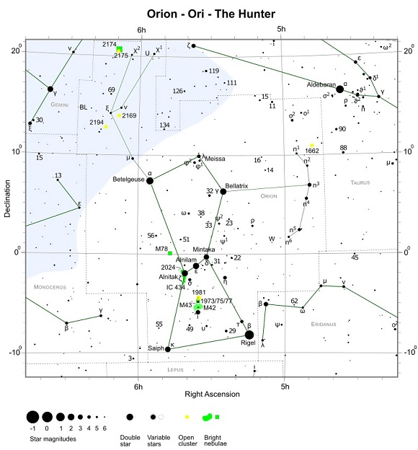
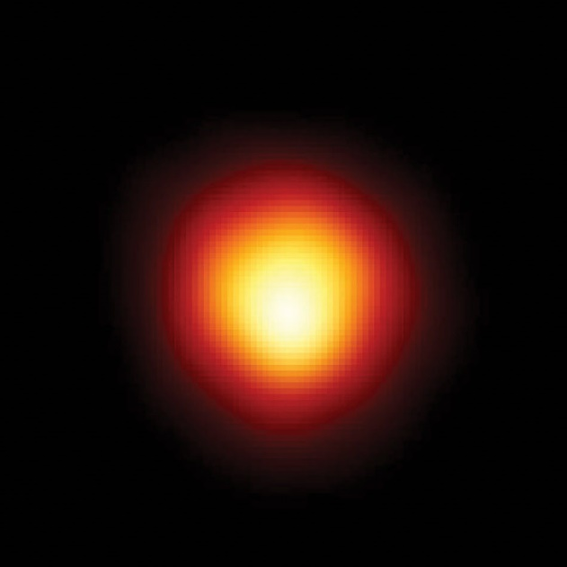
What is a Star? -- Differences
Our Sun: A yellow star,
~8 lm away, 6000 K,
~700,000 km (432,000 mi,
2 x 10³⁰ kg, 4.5 billion
years old, ~5 billion yr left
Aging
Rigel: A blue-white star, about
860 ly away, 12,000 K, 80 R_{O}
23 M_{O,} 8 million years old
Betelgeuse: A red-giant star,
About 650 ly away, 3500 K,
862 R_{O,} 20 M_{O,} 8.5 million
years old, ~100,000 years left
Brightness
Color

Slide 16
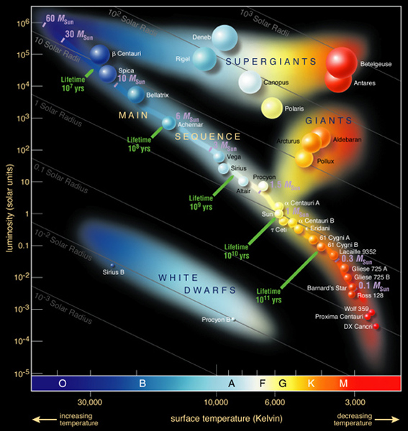
Hertzsprung-Russell Diagram
α-Cen-A is G2,
α-Cen-B is K1,
Proxima (α-Cen-C) is M6,
4.2 ly
Sun is G2
8.5 light minutes away
Betelgeuse is M2
643 ly
Rigel is B8
860 ly

Slide 17
What is the Sun like?

Slide 18

Anatomy of the Sun

Slide 19
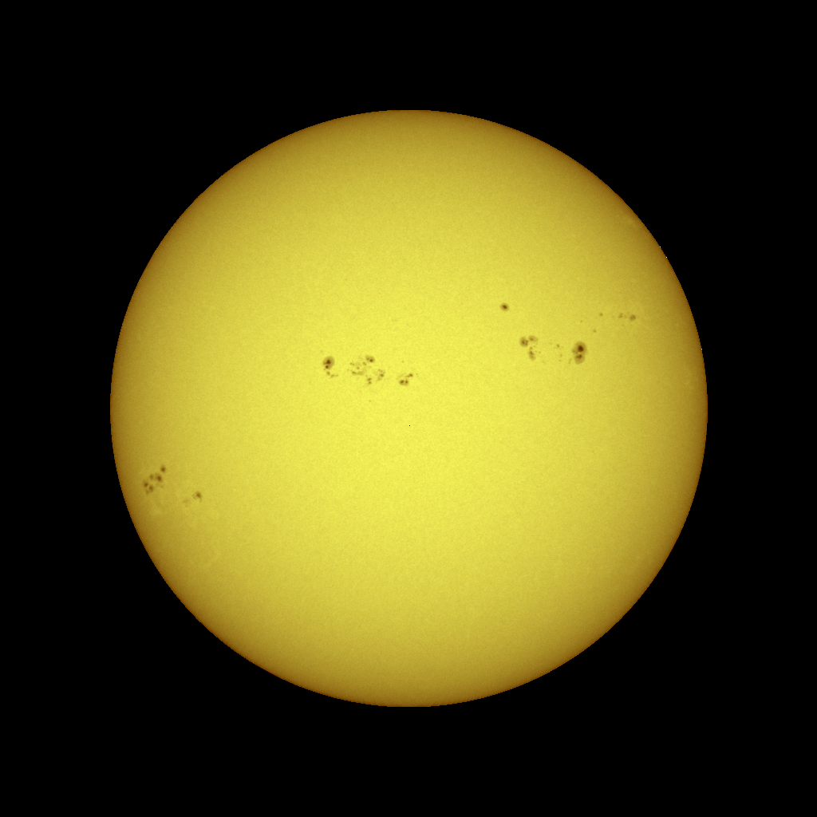
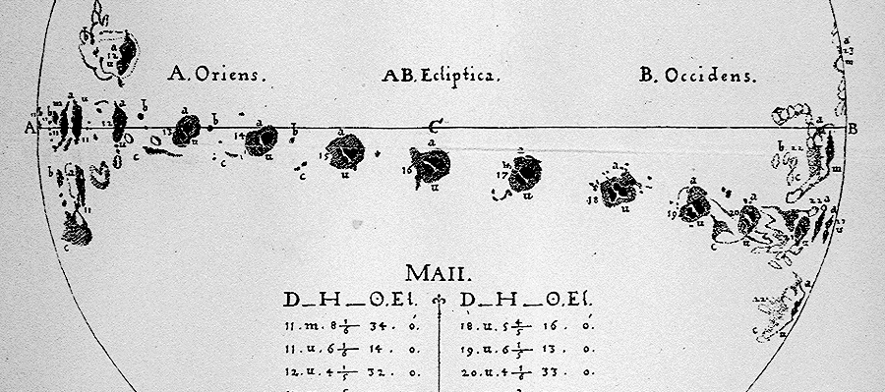

The Sun: Surface Features - Sunspots
Sunspots are regions that are cooler than their surroundings, produced by strong magnetic fields.
Sunspots have an Umbra surrounded by the lighter Penumbra.
Sunspots usually appear in groups, with lifetimes of days or weeks.
The earliest sunspot observations
(c. 1609) indicated that the Sun rotates once in about 27 days.

Slide 20
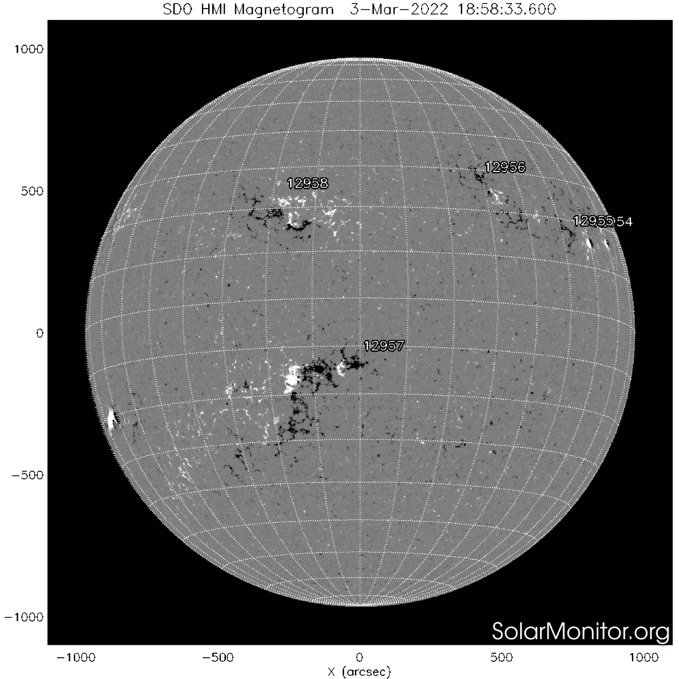
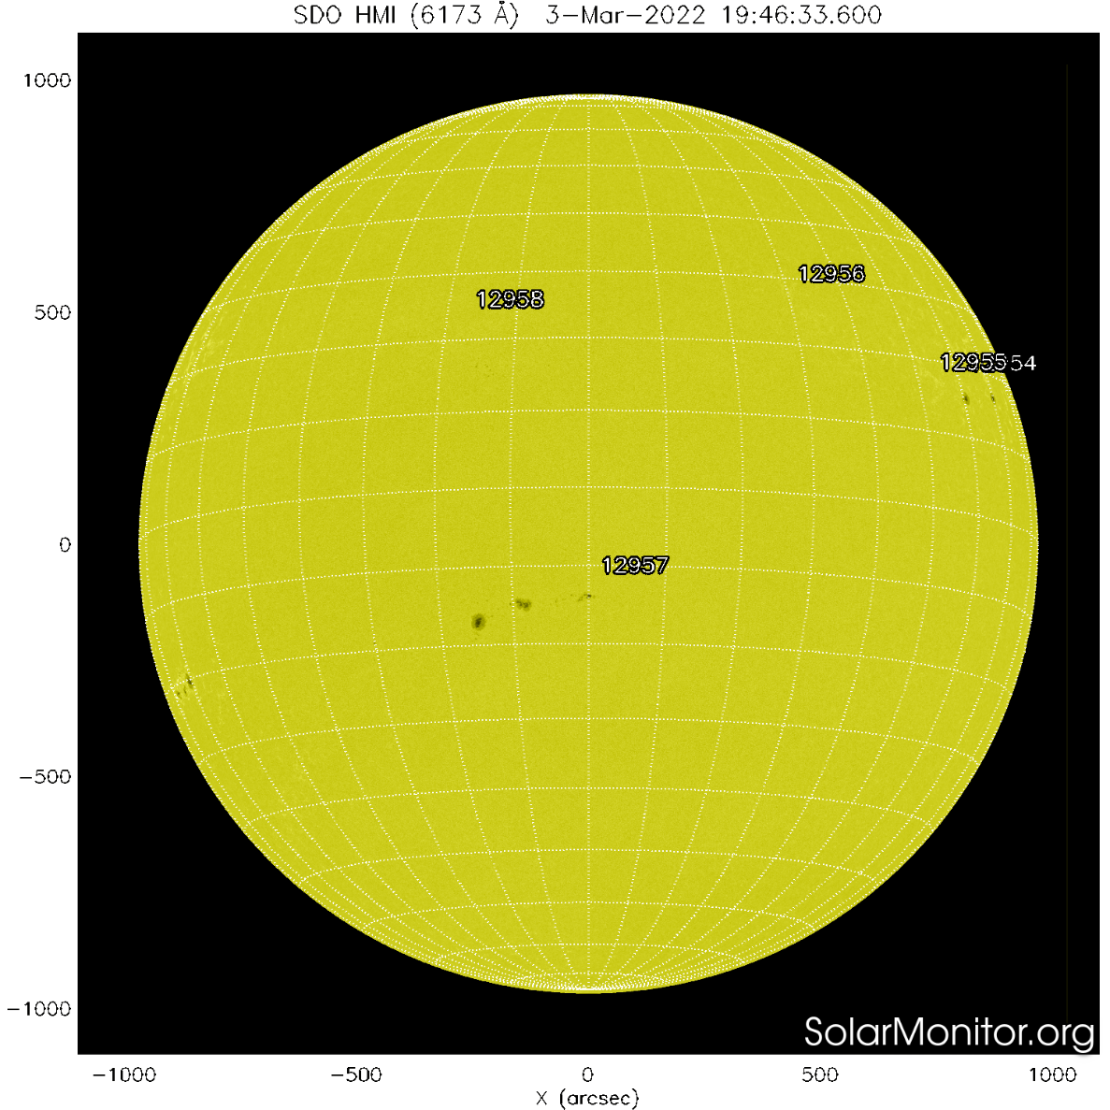
The Sun’s Magnetic Fields

Slide 21
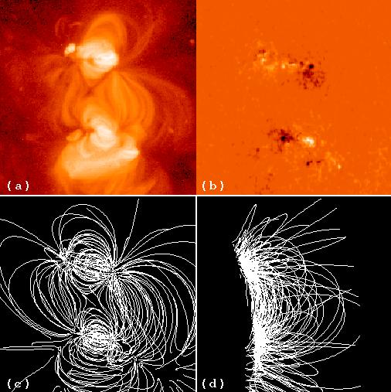
The Sun: Sunspot - Magnetic Fields
(a) Yohkoh Soft X-ray Telescope,
Corona
4 Jan, 1994 7:35 UT
(b) Line-of-Sight magnetic field
from Kitt Peak National Observatory
at 16:31 UT
(c), (d) Extrapolated Magnetic Field

Slide 22
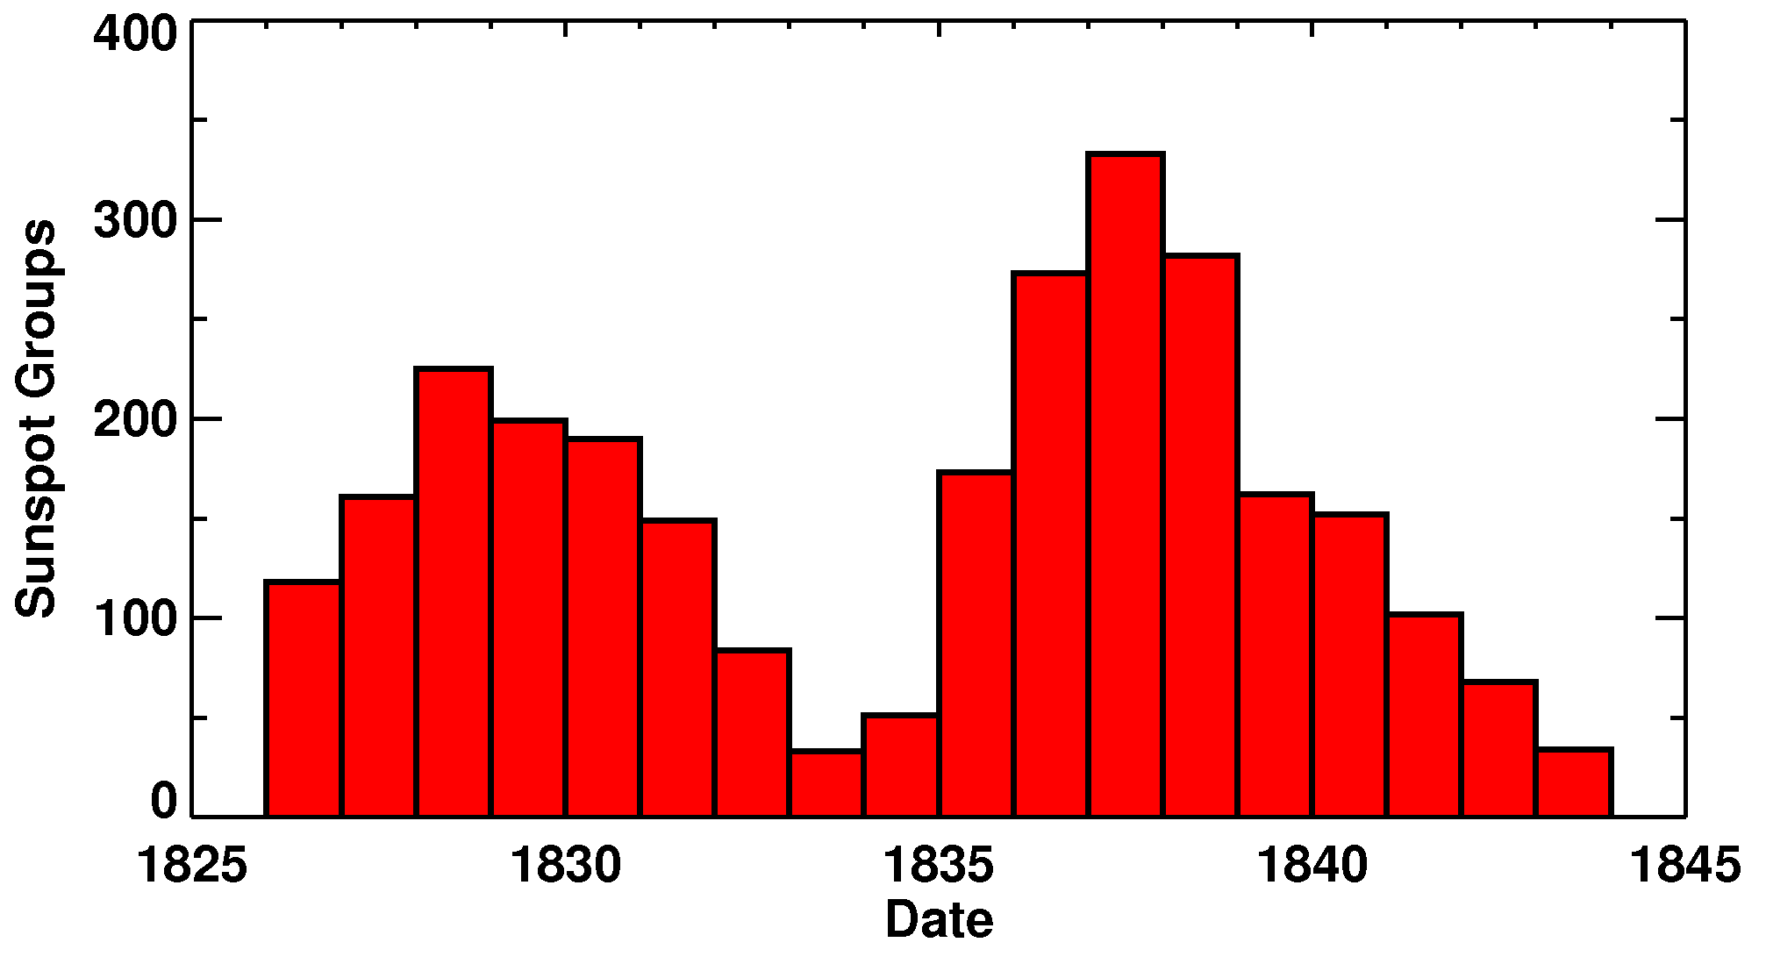
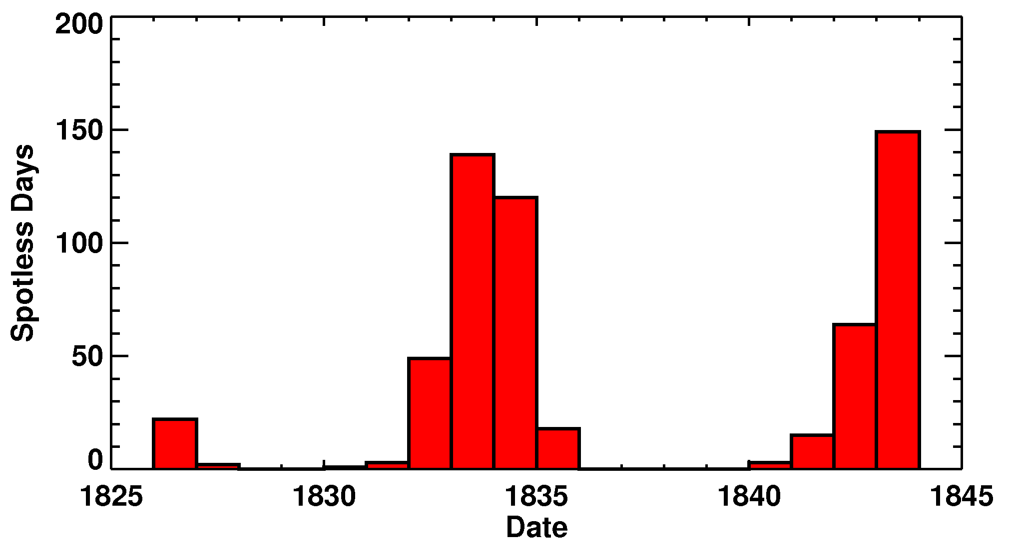
The Sun: Sunspot Cycle Discovery
Sunspots observed > 230 years
1844 Heinrich Schwabe, amateur astronomer, Dessau, Germany
Cycle: increase and decrease over ~10-years
- number of sunspot groups and the
- number of days without sunspots
Schwabe’s data for 1826 to 1843

Slide 23
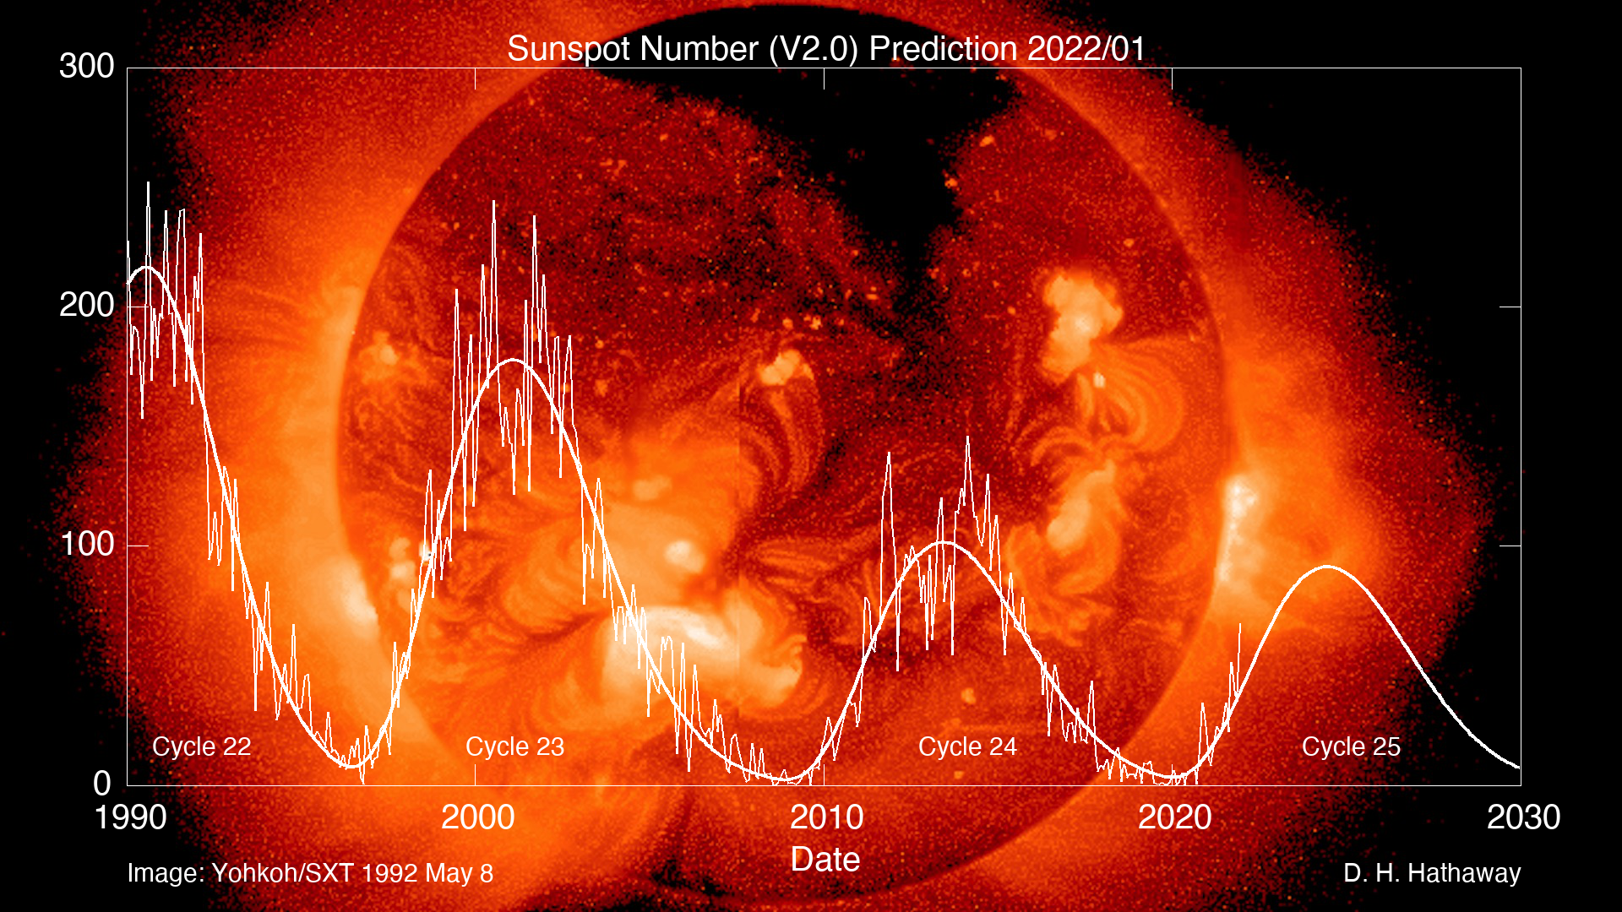
Sunspot Cycle
Rudolf Wolf 1849 -- “Relative” Sunspot Number = 10 times number sunspot groups + total distinct spots
Average cycle: ~11 years, -2, +3
Average amplitude: ~100, with range from 50 to 200
Image Used with Permission from Dr. David Hathaway

Slide 24
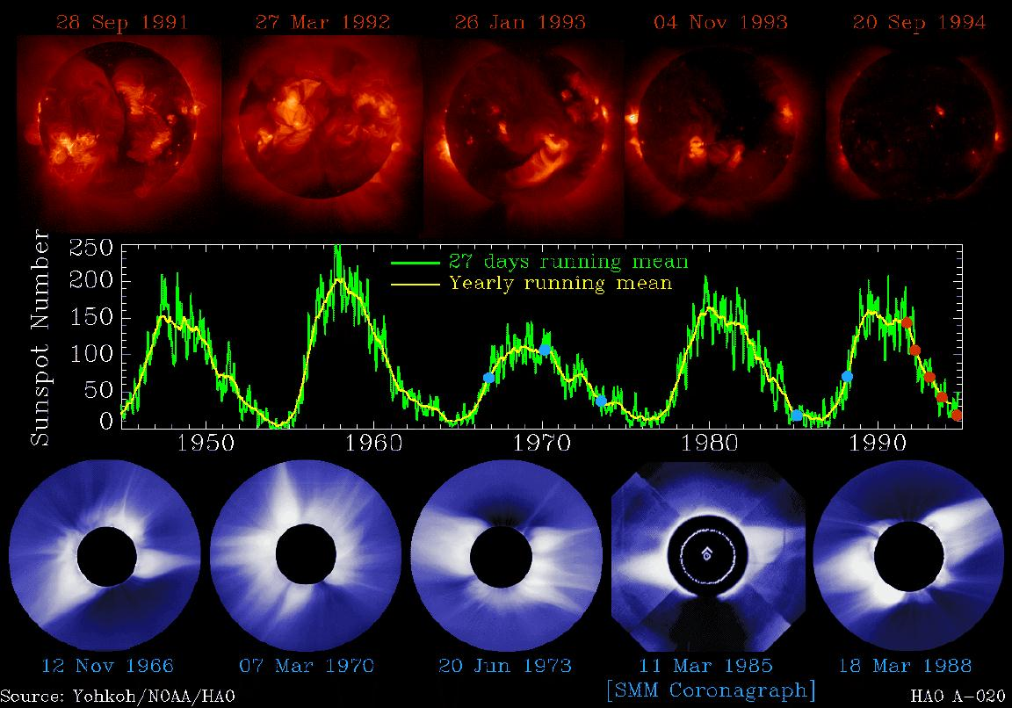
The Corona and the Solar Cycle

Slide 25
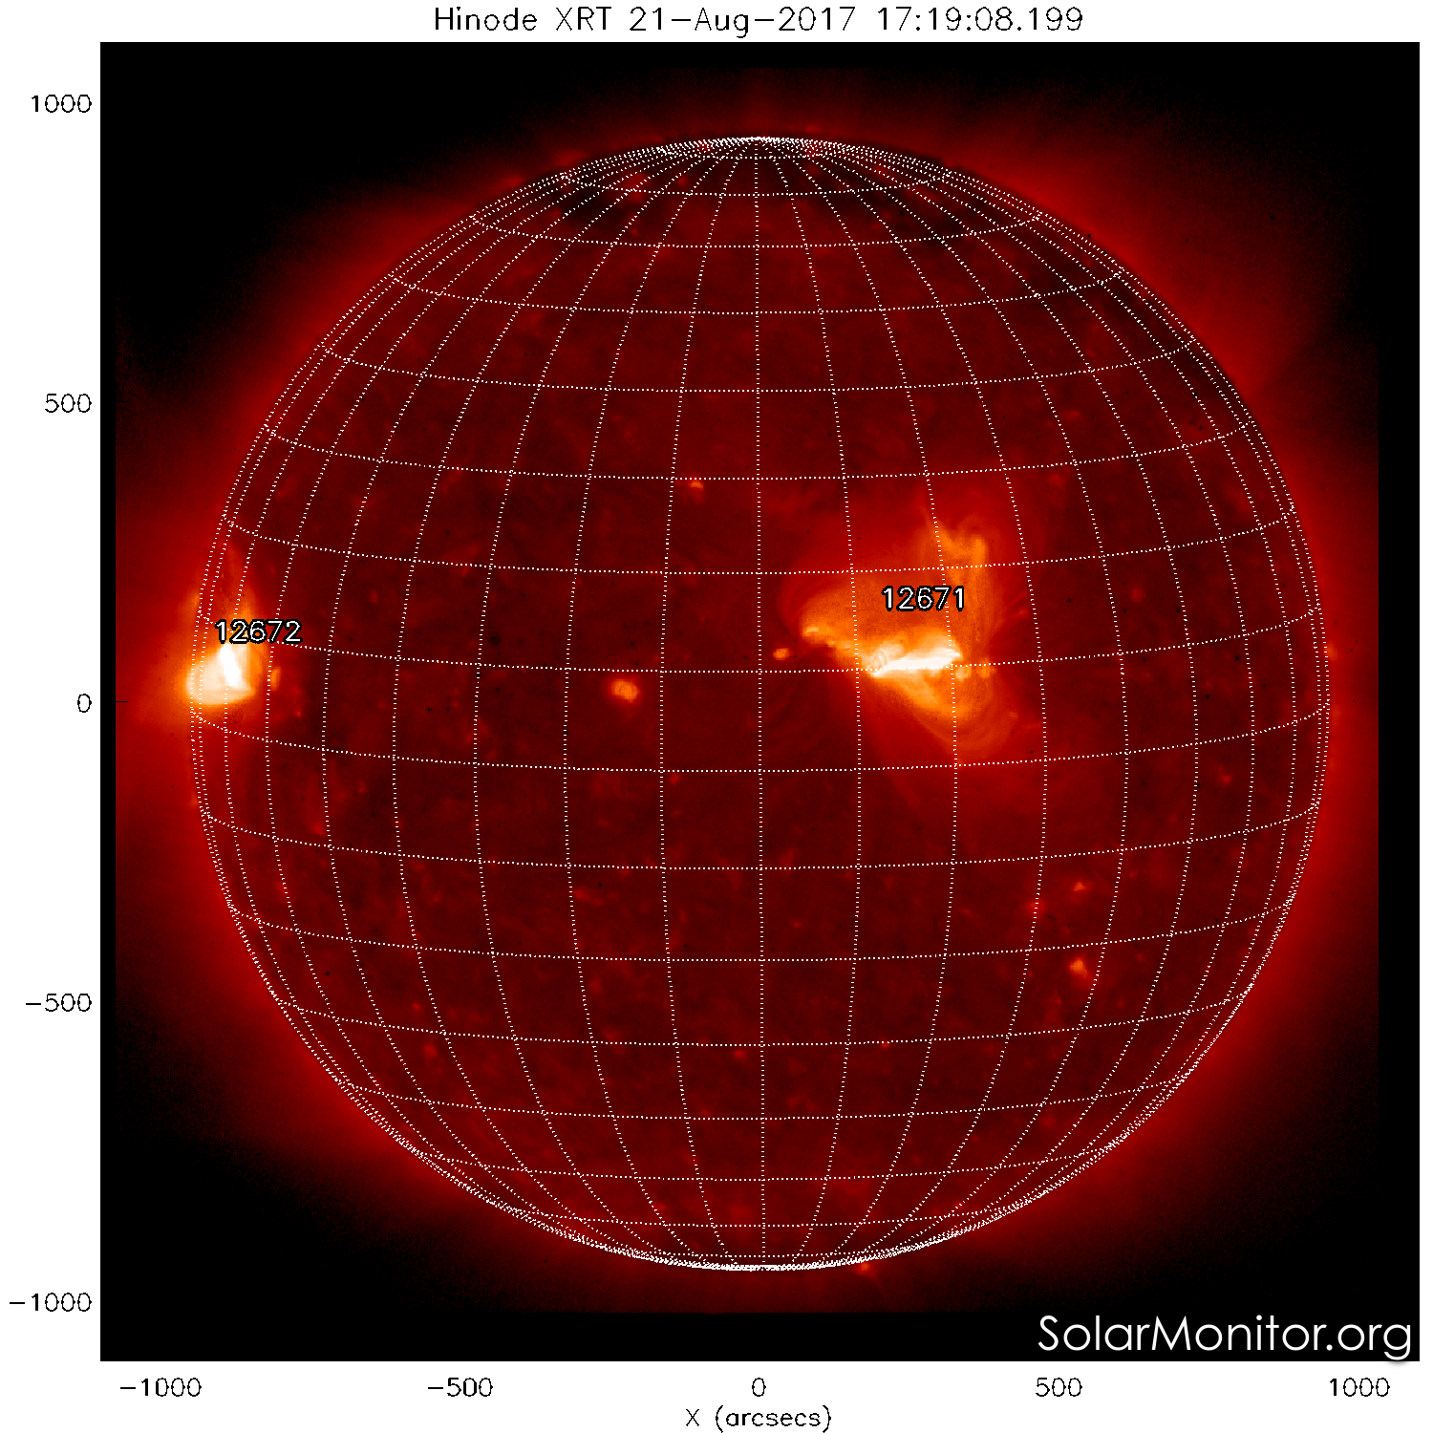
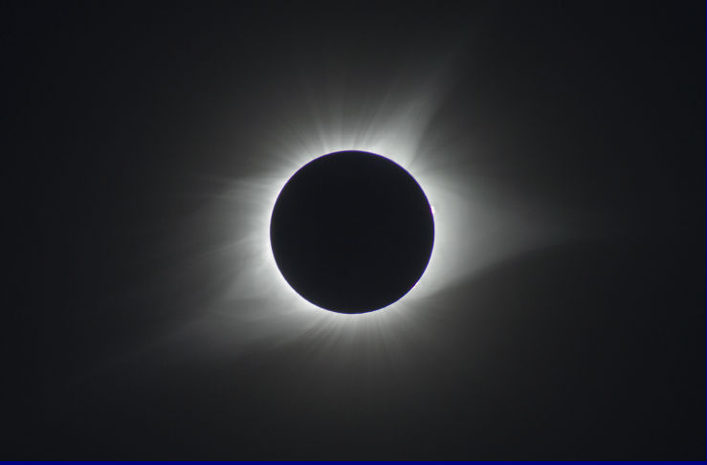
The Corona August 21, 2017
Image by Joe Matus, NASA/MSFC, taken from Hopkinsville, KY

Slide 26
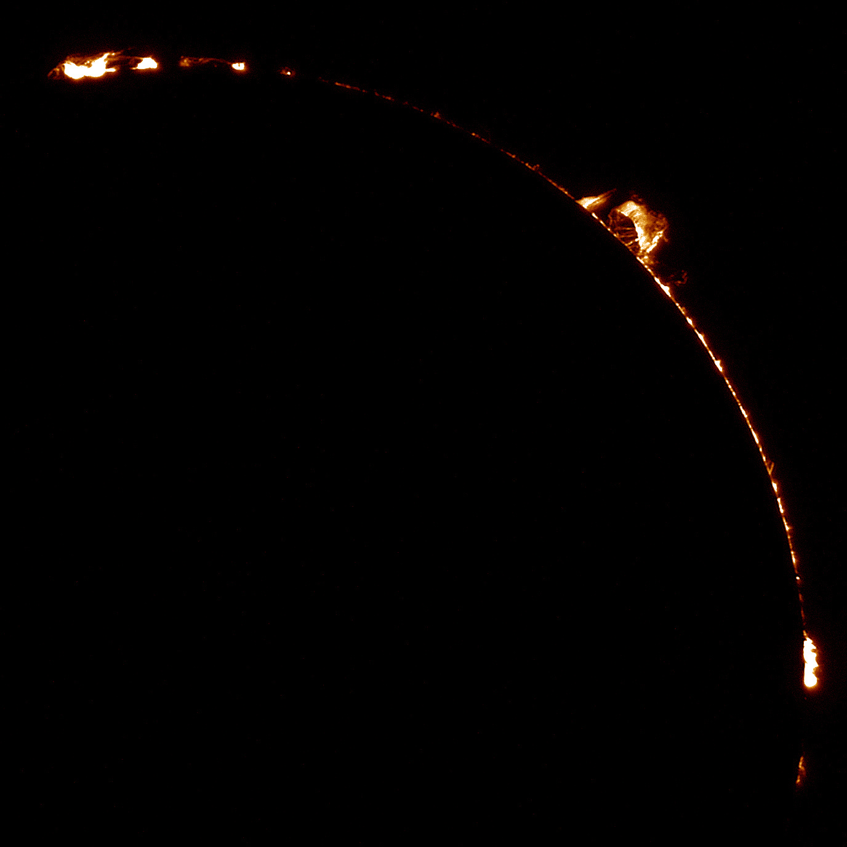
Total Solar EclipseAugust 21, 2017
Image Courtesy of Joe Matus, ST 24, NASA/MSFC

Slide 27
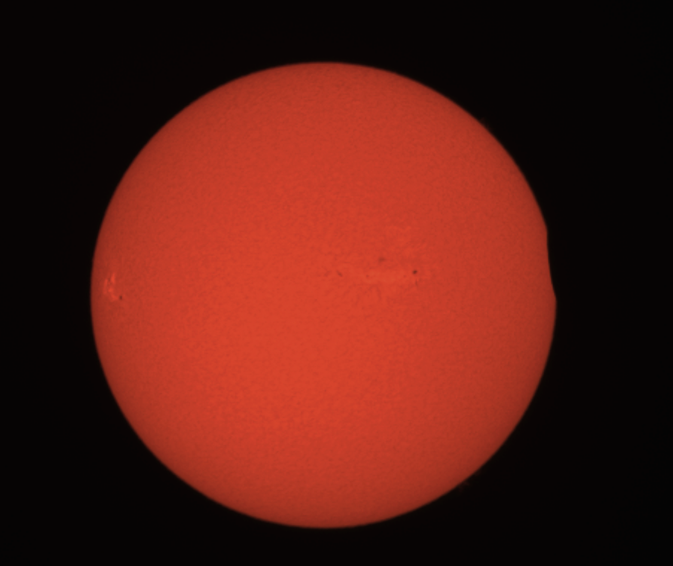
First Contact at Austin Peay State University (APSU)
Image: Mitzi Adams, NASA/MSFC
In the Light of Hydrogen-alpha

Slide 28
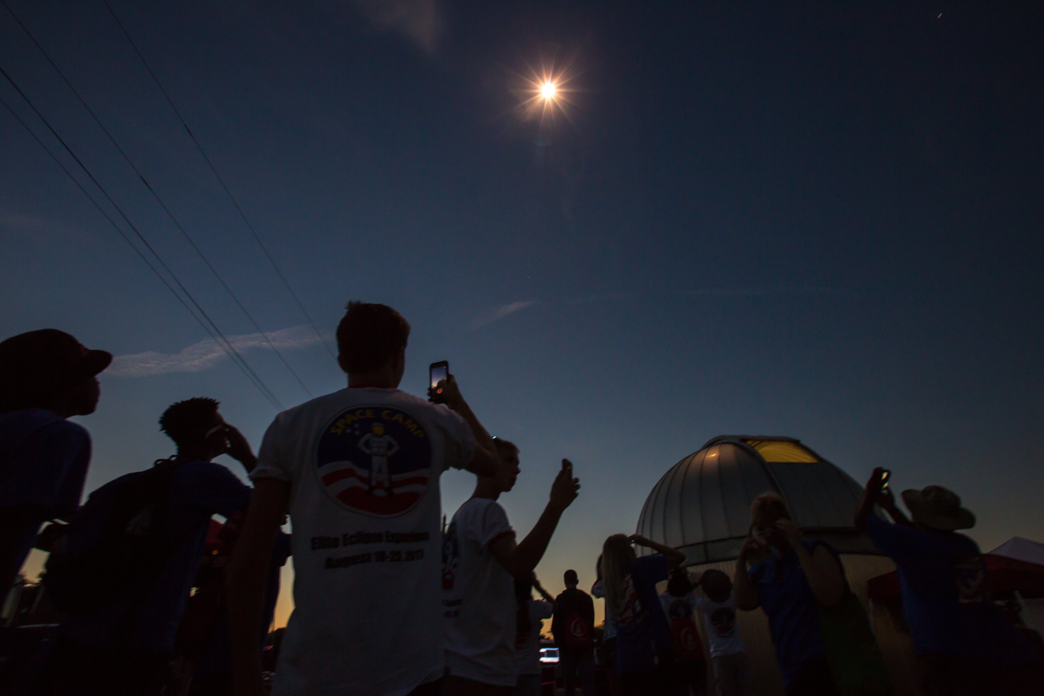
Totality at APSU

Slide 29
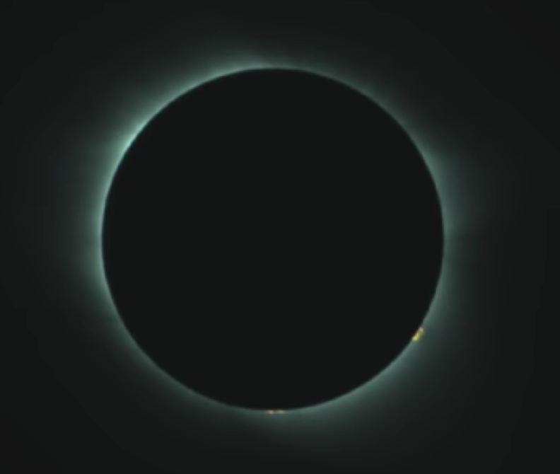
Totality at Hopkinsville, KY
Image from Dr. Jesse-Lee Dimech,
NASA NPP
Image from Joe Matus,
NASA/MSFC/ST24
Images Used with Permission

Slide 30
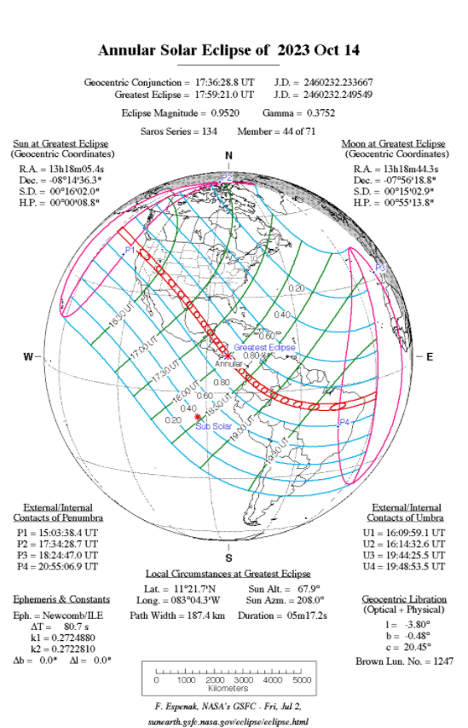
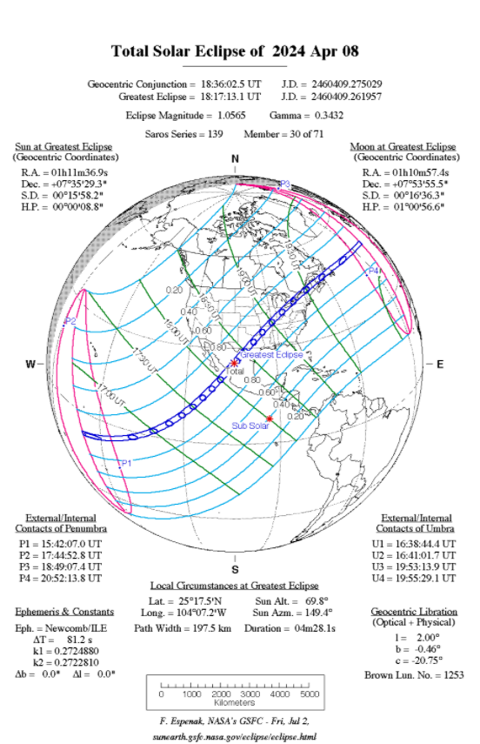
Next “Big” U.S. Eclipses

Slide 31
Solar Eruptions
Flares
Coronal Mass Ejections
Jets

Slide 32
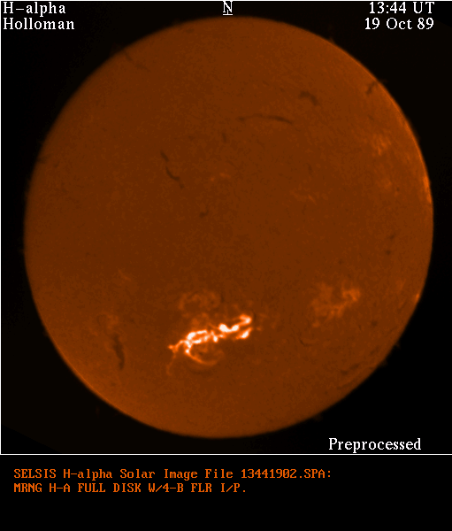
Solar Flares

Slide 33
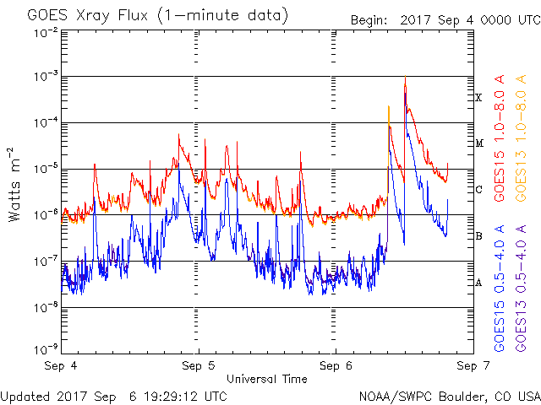
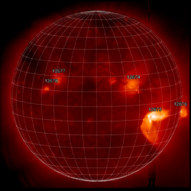
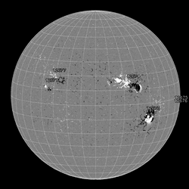
Solar Flare Classification
Sept. 6, 17:59 UT
Hinode X-Ray Telescope
(XRT) X9 flare
Sept. 6, 18:46 UT
SDO/Helioseismic
and Magnetic Imager
(HMI)

Slide 34
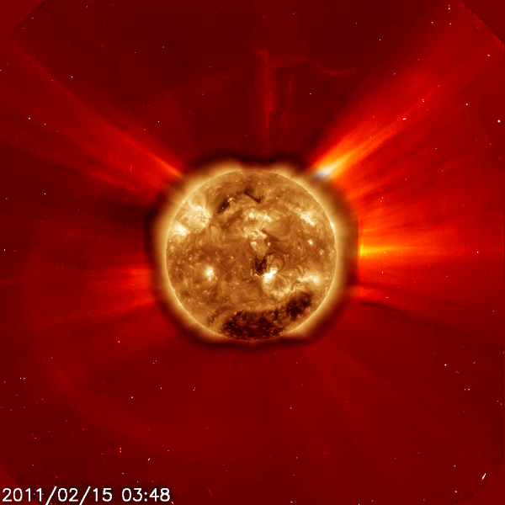
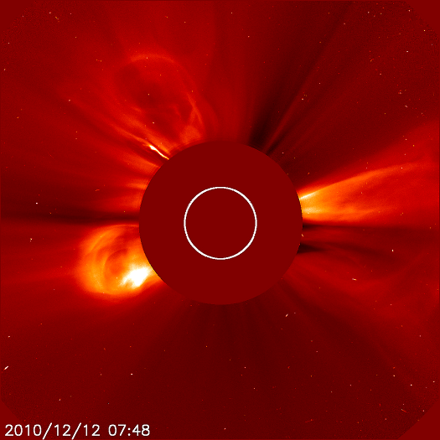
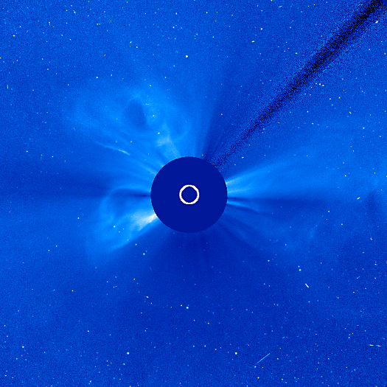
Solar Eruptions
Coronal Mass Ejections
SDO plus SOHO C2
X2-flare and halo CME
Three distinct CMEs
1. To right in both images, from a filament eruption,
2. From North Pole,
3. From far side of Sun.
All three eruptions happened within hours of each other.
Image Credit:
SDO and
SOHO/LASCO

Slide 35
Jets in Coronal Holes

Slide 36
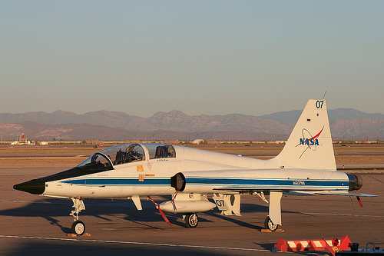
Coronal Jets
What is a Jet?
JET / noun – plural noun: jets
a rapid stream of liquid or gas forced out of a small opening."a high-pressure shower with pulsating jets", a nozzle or
narrow opening for sending out a jet of liquid or gas. "Agnes turned up the gas jet"
2. an aircraft powered by one or more jet engines."a private jet“. “Astronauts fly T-38 jets.”

Slide 37
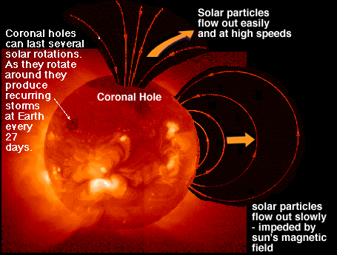
Coronal Holes in General
(in X rays)
Image is from Windows to the Universe
http://www.windows2universe.org/spaceweather/coronal_hole_mag_field.html

Slide 38
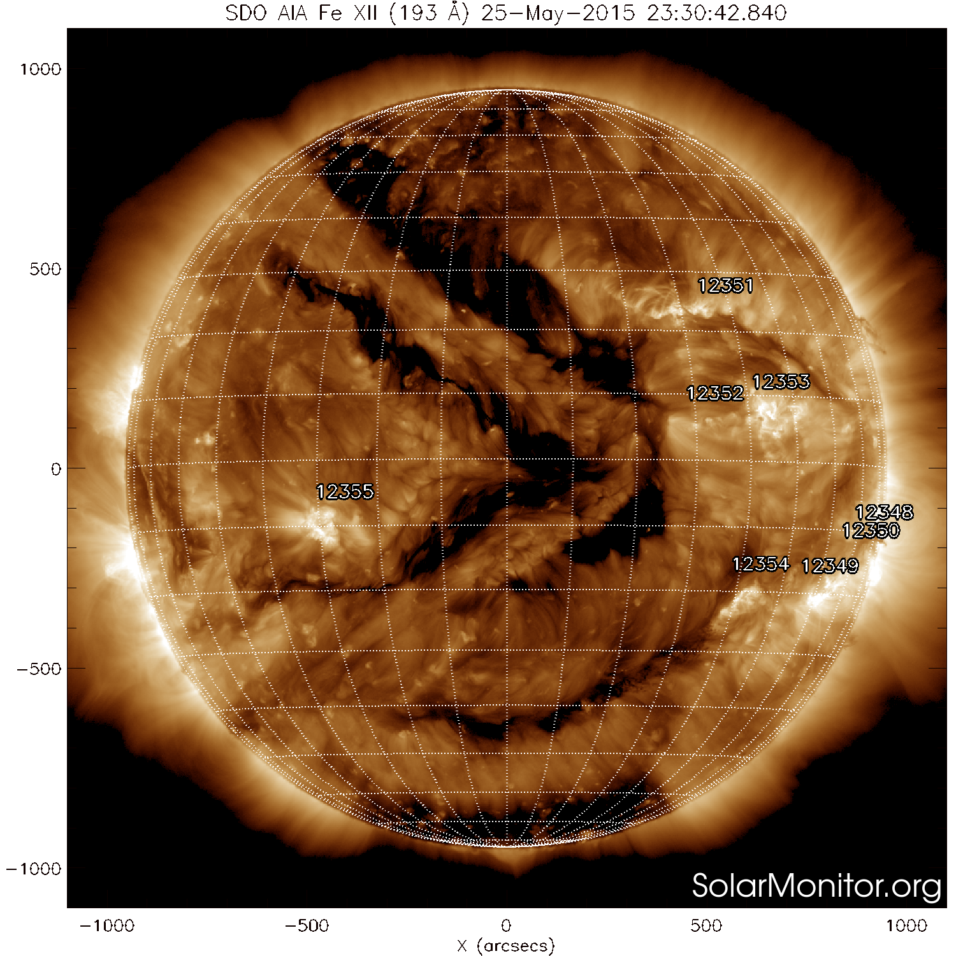
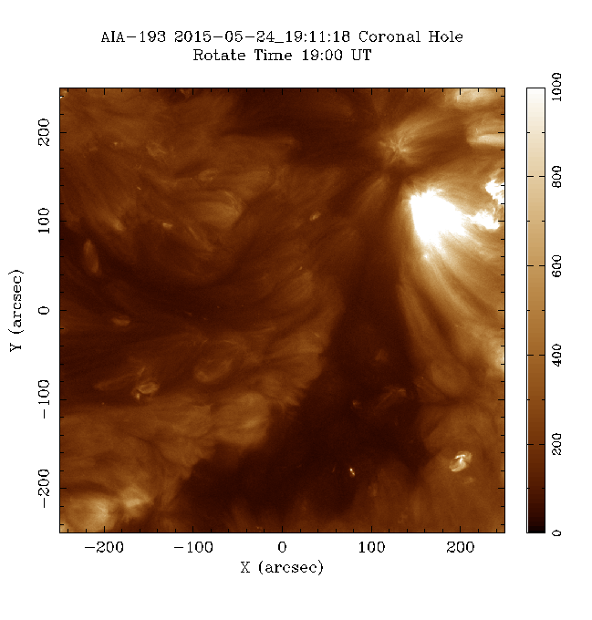
Corona Holes in General
(in EUV)

Slide 39
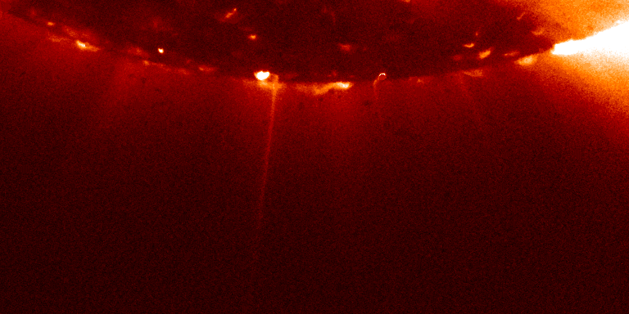
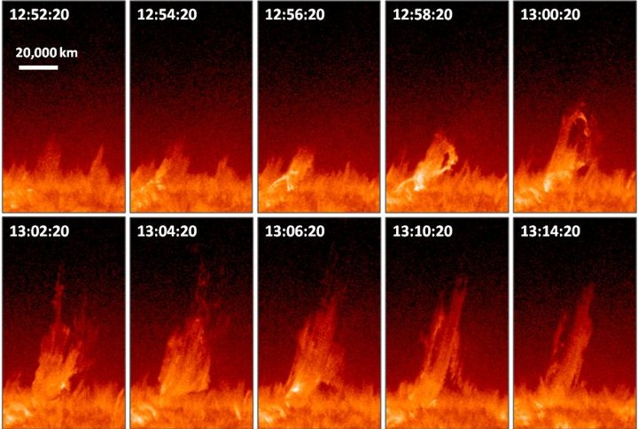
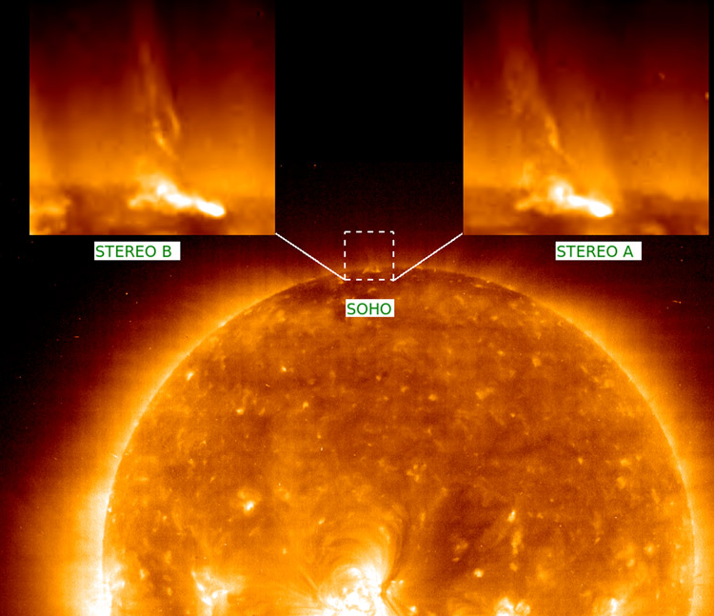
Solar jets can eject a million tons of
matter at a speed of a million miles per hour
(~45,000 km/s) in just a few minutes.
STEREO Stereoscopic Observations Constraining the Initiation of
Polar Coronal Jets
S. Patsourakos, E.Pariat, A. Vourlidas, S. K. Antiochos, J. P. Wuesler
The Astrophysical Journal Letters; June 10 2008
http://arxiv.org/abs/0804.4862
A Model for Solar Jets
E. Pariat, S.K. Antiochos, C.R. DeVore
Above is an example of a “blowout” jet, from a
northern polar coronal hole on 2010 October 2.
The images are from SDO's AIA in 304 Å.
From: The Cool Component and the Dichotomy, Lateral Expansion, and Axial Rotation
of Solar X-Ray Jets, R.L. Moore, et al., ApJ, 768:134 2013 June 1

Slide 40
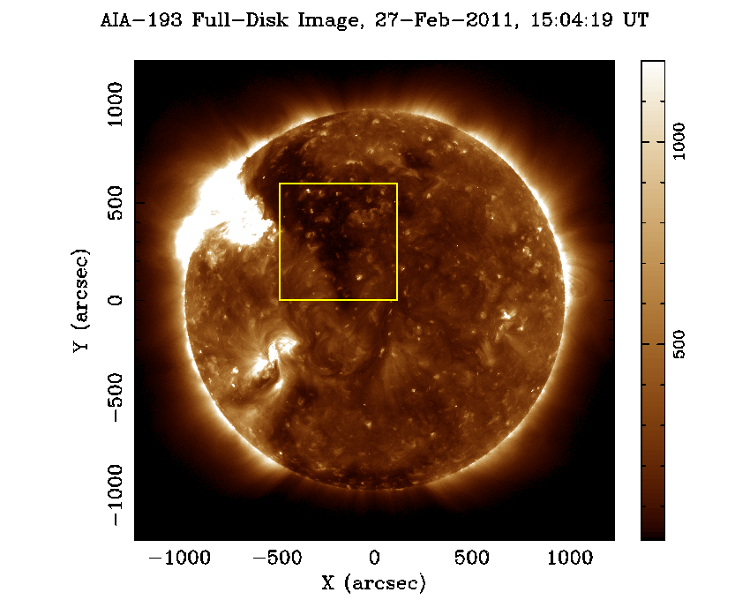

Jets in Coronal Holes
This jet has a component with
speeds > 200 km/s (1 min).
In 304 Å, speeds are
~ 80 km/s (4 min.)
Coronal Mass Ejections have typical speeds
of about 300 km/s, but can range from
100 - 3000 km/s

Slide 41
Summary
Our Sun is a single star with a system of planets
The Sun is a stable star, happily converting hydrogen to helium
The Sun will remain on the Main Sequence of ~ 4.5 billion years more
The Sun is an active star, which produces spots, flares, and coronal mass ejections
Jets of all sizes occur on the Sun.
The mechanism for producing the jets seems to be similar at all scales.
Because chromospheric jets can trigger flares and CMEs, which can affect Earth, it is important to
understand all jets.
Will the Sun end its life with a bang or a whimper?

Slide 42
Backup Slides

Slide 43

Jet Formation (Cartoon) Solar X-ray Jets
The commonly accepted mechanism for jet formation: Black lines represent magnetic field, with
arrows indicating polarity; the yellow curve is the solar limb; the thick red curve in a represents a
plasma current sheet; the red cross in b shows the location of field reconnection. a, Initial state.
b, Jet formation: flux emergence purportedly forces reconnection at the current sheet (red cross),
resulting in new closed-loop field (red loop), and new connections to the open coronal field
(thin red line), along which the X-ray jet (purple) flows. According to this model, the new
reconnection loops appear as the JBP.

Slide 44

Jet Formation (Cartoon) Solar X-ray Jets
(Revised)
Representation of the minifilament-eruption process that drives the formation of solar X-ray jets,
as inferred from our observations. Black lines represent magnetic field, with arrows indicating
polarities; red curves are newly reconnected field lines; blue features are minifilament material;
yellow curve is the solar limb (the apparent edge of the Sun). From the initial state (a), the jet
forms as the minifilament erupts (b, c), with reconnection locations indicated by red crosses (b, c).
The JBP (bold red arc) forms at the location of filament lift-off (b, c). See Methods for more details.

Slide 45


